Slide 1

Internet of Things
Lesson 4

Slide 2
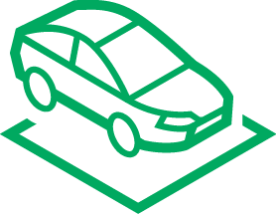




Embedded systems
Anything with a processor in it!
Examples of embedded systems:
Cars
TVs
Games consoles
Printers
Cameras
Wearables
Micro:bit

Slide 3
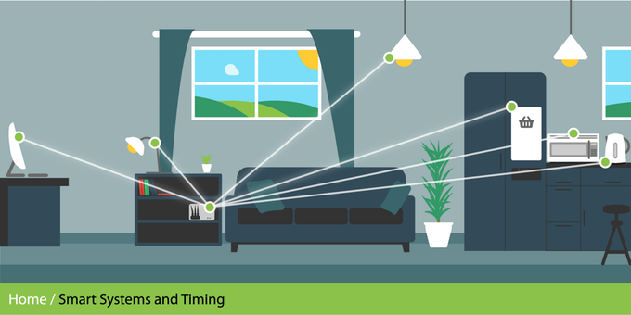
What is IoT?
Internet of Things (IoT)
Adding electronics to everything
Electronics such as:
Sensors (cameras, temp, light, humidity etc.)
Microprocessors (like the micro:bit)
Screens
Everything can link to the internet/each other
Anything electronic can be controlled
Can stream data continuously
Notes:
Introduce the concept of the IoT. This allows a wide range of household object to communicate with each other. They use sensors, microprocessors and screens. They allow all of the different items to link together and communicate with each other. You could give the example of a connected light bulb. This could be turned on and off from a mobile telephone. You could change the colour, brightness, set up timings all from the mobile phone.

Slide 4








Example: IoT
IoT devices typically have:
Sensors
CPU
Radio
Security
Connectivity
Services
Notes:
Internet of things devices will need to be contain a number of different elements to work. Learners will find the technical nature of the terminology but it is worth providing a brief overview. They will need sensors to be able to detect things in the outside world. You could use the example of the accelerometer and compass that is built into the micro:bit. They will need an MCU (microprocessor control unit). An example of this is the micro:bit. They will need radio so that they communicate with other devices wirelessly. They need security to stop other people from connecting to them that don’t have permission to do so. They need to be able to connect with other devices for example a light bulb connecting to a mobile telephone. They also need services i.e. they need to do something when you connect to them e.g. turning the light bulb on and off.

Slide 5
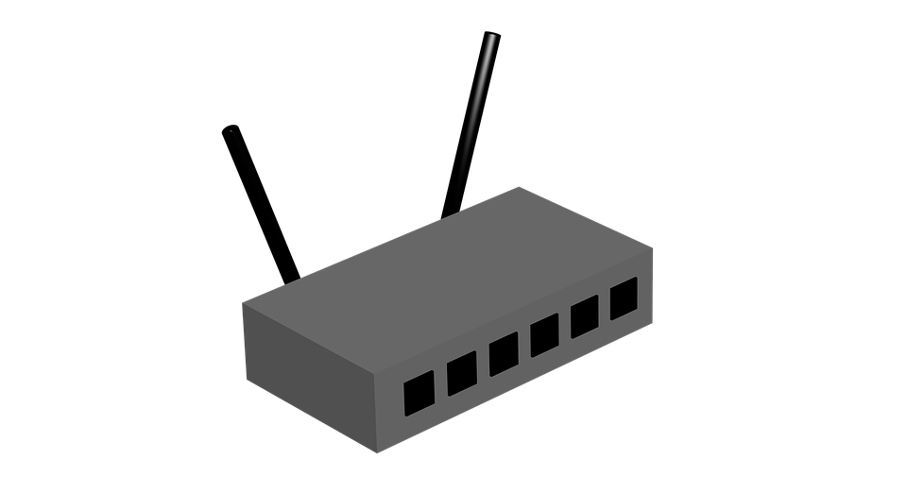

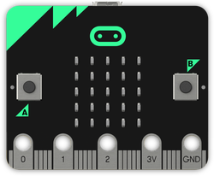
How IoT works
Long range (up to 50km)
Sensors
GATEWAY
(to the internet)
Data scientists use the data to make decisions
3/4/5G
WiFi
LoRa
Sigfox
NODE
Notes:
Node transmits to gateway over a long range using 3G (mobile network) or LoRa/SigFox
Gateway receives data and then transmits it to the internet
The data scientists receive the data on a PC or mobile device

Slide 6
Input, Process, Output (IPO)
Input
Process
Output
Sensors (produce data)
Temperature sensor
Light sensor
Accelerometer
Microphone
Camera
Wi-Fi
Bluetooth
Takes input data
Does something with the data
Stores the data
Transmits the data
Motors/servos
LEDs (micro:bit screen)
Sound
Wi-Fi
Bluetooth
Notes:
The concept of IPO and IoT has now been covered. The two should now be connected together. Give a brief overview of the different input and output devices that could be used by IoT connected devices.

